Slide 1

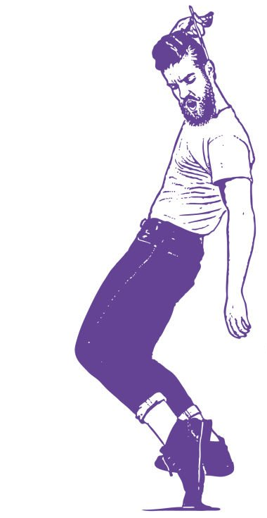
GNOOTIP
Find the music you will love
the new song recommender by GNOD

Slide 2
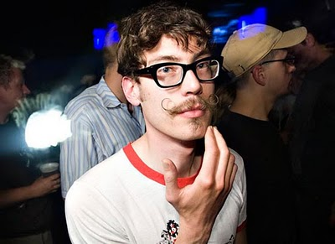




HARRY
GOALS
→ discovering new music of any types, reflecting the diversity he likes
→ sharing my passion for music with other music lovers all over the world (and why not meeting them when he is travelling ?)
BIO
Harry is a nomad worker, freelancing as web designer. He travels a lot, always with headphones on his ears. Wherever he goes, he loves to party and discover local music. As an heteroclite music lover, he feels frustrated with the apps and tools he uses to listen and discover music : it never reflects the diversity he loves.
FRUSTRATIONS
→ spotify and youtube algorithms don’t do the job, he feels they propose him random music (his tastes being so diverse…)
→ he didn’t find yet the perfect app to discover new music, taking into account what he already liked and his current mood.
I want to find an interactive and collaborative tool that will allow me to discover new music and share it with a community of music lovers.
PERSONALITY
Introvert
Extravert
Analytical
Creative
AGE - 32 years old
JOB - Freelance Web Designer
FAMILY - Single
LOCATION - London
ARCHETYPE - Motley Music Lover
TOOLS & APPS
Observative
Intuitive
Passive
Active

Slide 3


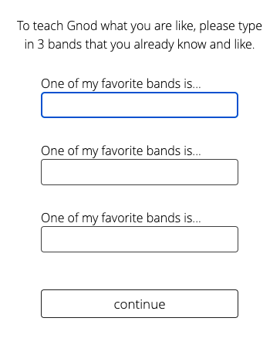
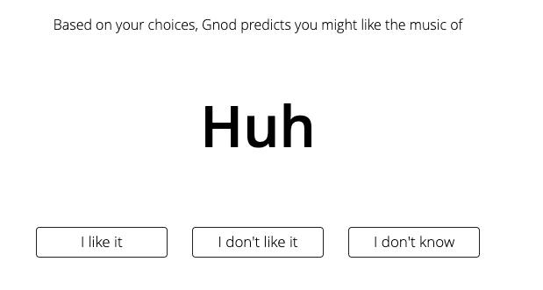
One day, Harry discovers Gnoosic thanks to a web media that he follows on social media…
at first sight, he felt very happy :
“finally a new app, I hope it will work well !”

Slide 4


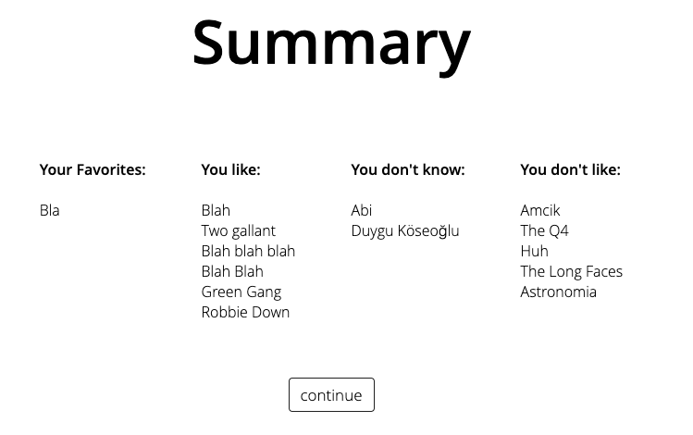
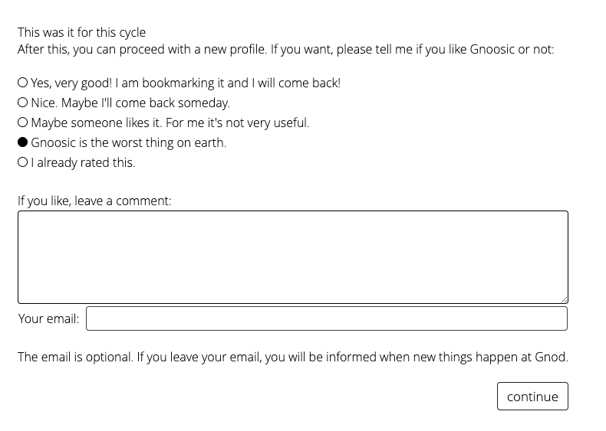
But going through the app, Harry felt more and more disappointed…
“Really ? Is that all ? Not even some links to discover the artists on social media… must be a student project…”
He remains very hungry…
“No way I let my email address…”

Slide 5

HOW TO PLEASE HARRY ?
→ with GNOOTIP…

Slide 6

Recommend songs (not only bands)...
…that are actually similar to the ones they picked from an acoustic point of view…
…or that are popular around the world right now

Slide 7
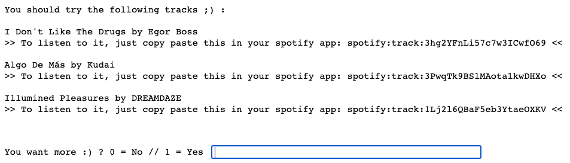
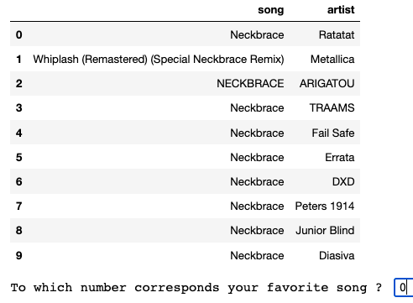

What we came up with…
The user input a song that he loves
2. The app retrieves the given song from spotify database (and ask to precise if needed)
3. The app advises 3 songs related to the user’s taste with a link to try it
4. Ask for feedback and email address (useful to create a community)

Slide 8

To make GNOOTIP the perfect song recommender, we would need more budget to…
add many songs and playlists (objective = 100k songs) to the model to increase its performance and recommend songs that are very close to the user’s input
create a beautiful web interface, with the videoclip and direct link to spotify url
create an interactive community of music lovers to implement a collaborative and machine learning algorithm
communicate on this new app and share it everywhere

Slide 9


HARRY IS HAPPY

